Slide 1
William Stallings Data and Computer Communications
Chapter 1
Introduction

Slide 2
A Communications Model
Source
generates data to be transmitted
Transmitter
Converts data into transmittable signals
Transmission System
Carries data
Receiver
Converts received signal into data
Destination
Takes incoming data

Slide 3
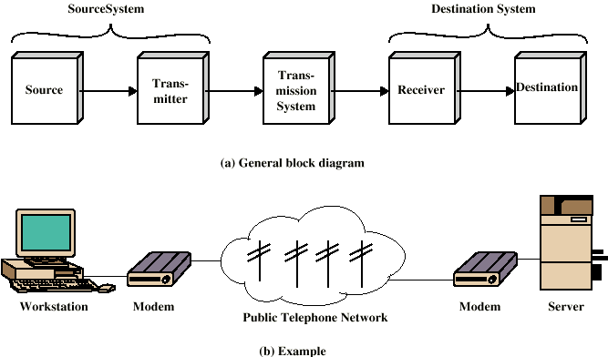
Simplified Communications Model - Diagram

Slide 4
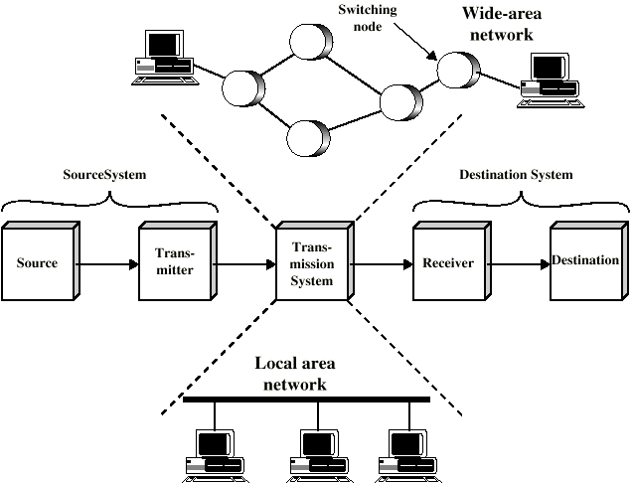
Networking
Point to point communication not usually practical
Devices are too far apart
Large set of devices would need impractical number of connections
Solution is a communications network

Slide 5
Circuit Switching
Dedicated communications path established for the duration of the conversation
e.g. telephone network

Slide 6
Packet Switching
Small chunks (packets) of data at a time
Packets passed from node to node between source and destination
Used for terminal to computer and computer to computer communications
Data sent out of sequence

Slide 7
Integrated Services Digital Network
ISDN
Designed to replace public telecom system
Wide variety of services
Entirely digital domain

Slide 8
Asynchronous Transfer Mode
ATM
Evolution of frame relay
Little overhead for error control
Fixed packet (called cell) length
Anything from 10Mbps to Gbps
Constant data rate(Circuit Switching) using packet switching technique

Slide 9
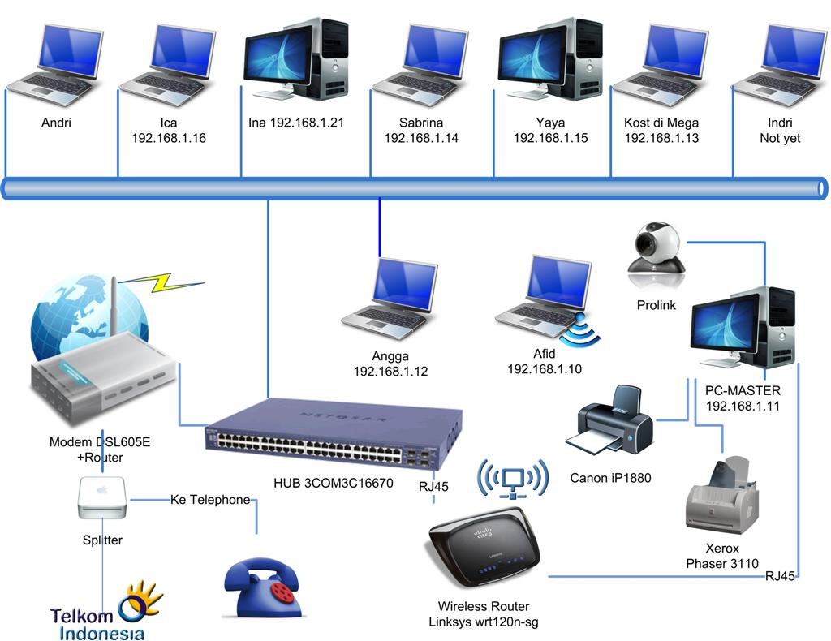
Local Area Networks
Smaller scope
Building or small campus
Usually owned by same organization as attached devices
Data rates much higher
Usually broadcast systems
Now some switched systems and ATM are being introduced

Slide 10
Protocols
Used for communications between entities in a system
Must speak the same language
Entities
User applications
e-mail facilities
Systems
Computer
Terminal
Remote sensor

Slide 11
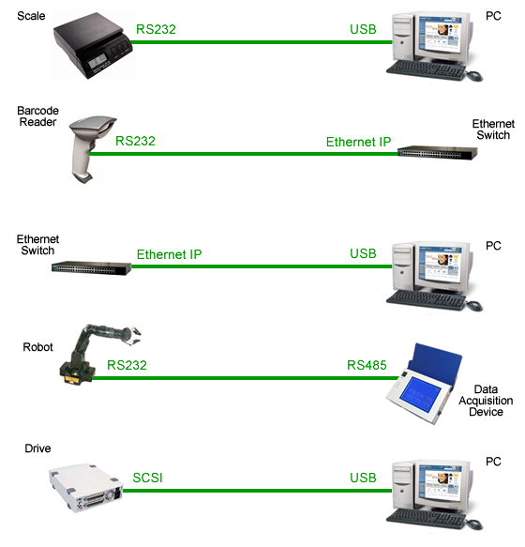
Key Elements of a Protocol
Syntax
Data formats
Signal levels
Semantics
Control information
Error handling
Timing
Speed matching
Sequencing

Slide 12
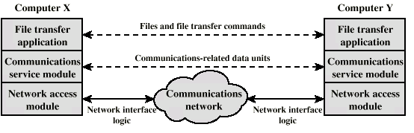
Protocol Architecture
Task of communication broken up into modules
For example file transfer could use three modules
File transfer application
Communication service module
Network access module

Slide 13
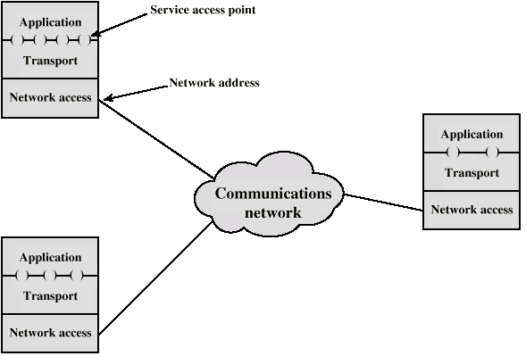
Addressing Requirements
Two levels of addressing required
Each computer needs unique network address
Each application on a (multi-tasking) computer needs a unique address within the computer
The service access point or SAP

Slide 14
Protocol Data Units (PDU)
At each layer, protocols are used to communicate
Control information is added to user data at each layer
Transport layer may fragment user data
Each fragment has a transport header added
Destination SAP
Sequence number
Error detection code
This gives a transport protocol data unit

Slide 15
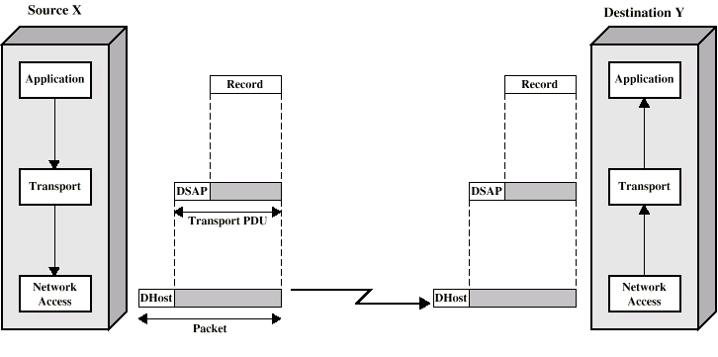
Operation of a Protocol Architecture

Slide 16
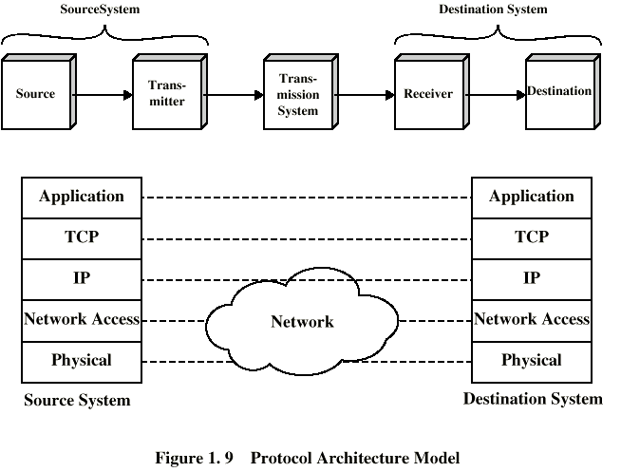
TCP/IP Protocol Architecture
Developed by the US Defense Advanced Research Project Agency (DARPA) for its packet switched network (ARPANET)
Used by the global Internet
No official model but a working one.
Application layer
Host to host(transport layer)
Internet layer
Network access layer
Physical layer

Slide 17
OSI Model
Open Systems Interconnection
Developed by the International Organization for Standardization (ISO)
Seven layers
A theoretical system delivered too late!
TCP/IP is the de facto standard

Slide 18
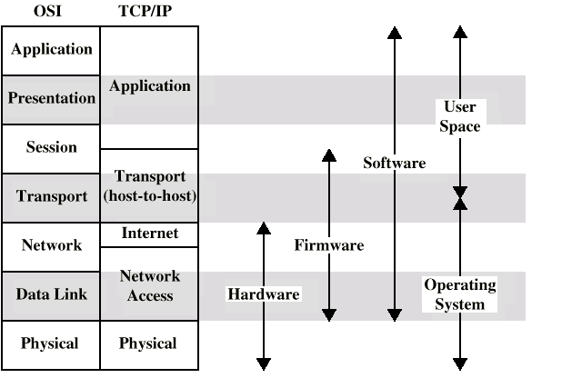
OSI Layers, OSI vs TCP/IP
Application
Presentation
Session
Transport
Network
Data Link
Physical

Slide 19
Standards
Required to allow for interoperability between equipment
Advantages
Ensures a large market for equipment and software
Allows products from different vendors to communicate
Disadvantages
Freeze technology
May be multiple standards for the same thing

Slide 20
Standards Organizations
Internet Society
ISO
ITU-T (formally CCITT)
ATM forum

